Slide 1

Gwyrosydd News
July 2025
Annwyl Parents & Carers,
As we come to the end of this final week of term, I want to take a moment to reflect on what has been a truly wonderful first term as Headteacher at Gwyrosydd. I have felt incredibly welcomed by the entire school community, and I’ve been so impressed by our pupils’ creativity, hard work, politeness, curiosity, resilience, and kindness. On behalf of myself and the Governors, I would like to extend a heartfelt thank you to all of our staff for their continued dedication and commitment to making a real difference in the lives of our pupils. Thank you also to all of our parents and carers for your ongoing support - working together, we are making Gwyrosydd the best it can be.
A reminder that the last day of term for pupils will be Thursday 17th July. School will then be closed for the summer holidays. Looking ahead to the new academic year, please note that there will be an INSET day on Monday 1st September, so pupils will return to school on Tuesday 2nd September. Additionally, a second INSET day has been arranged for Monday 15th September, during which school will again be closed to pupils.
Curriculum Corner
It’s been a vibrant and exciting time in school, filled with hands-on learning, creativity, and unforgettable experiences!
In our younger classes, joined handwriting has been a strong focus, and the children have been amazing us with their brilliant story writing – Mrs Edwards has been very impressed. Nursery have been out and about, enjoying a fun-filled trip to Folly Farm - an adventure packed with exploration and joy!
STF have been busy in the kitchen, making delicious scones in preparation for a very special afternoon tea - what a wonderful way to combine life skills with learning!
Pupils across the school were thrilled to attend the Welsh Gig at Pentrehafod. A standout moment was when Calon Lân was played - a song very close to our hearts. The children also enjoyed choosing songs, with Hey Mr Urdd quickly becoming a crowd favourite.
Our talented Year 4 and 5 pupils have been putting the final touches on their film projects, bringing their creative ideas to life and getting ready to share their hard work.
Meanwhile, Year 6 have been making the most of their final weeks - taking part in transition activities and preparing for their leavers' celebrations as they get ready to move on to the next exciting chapter.
We can’t wait to move into our new classes and Pods in September for another exciting year ahead!

Slide 2

Goodbye and Good Luck Year 6!
As we say goodbye to our wonderful Year 6 pupils, we celebrate the incredible journey they’ve taken with us - from their very first days in Nursery, full of curiosity and wide-eyed wonder, to the confident, capable young people they’ve become. Along the way, they have grown not just in knowledge, but in character - showing resilience, kindness, leadership, and a strong sense of community. It has been a privilege to watch them learn, laugh, make lasting friendships, and rise to every challenge. As they move on to the next exciting chapter in their lives at comprehensive school, we are so proud of all they have achieved and know that they will continue to shine.
Gwyrosydd will always be cheering you on Year 6!
Farewell, Thank You and Best Wishes!
This term, we say a heartfelt and emotional farewell to Mr. G. Davies, who retires after an extraordinary 33-year teaching career, with 14 of those invaluable years here at Gwyrosydd. Mr. Davies is not only a dedicated educator but a truly special person who has touched the lives of countless pupils, families, and colleagues. His kindness, patience, and unwavering support have made a lasting difference to our school community. His wisdom, humour, and calm, reassuring presence will be deeply missed – Mr G (As he is known,) is a great loss to Gwyrosydd and to the wider community. On behalf of everyone at the school, we thank him for his outstanding service and wish him every happiness, good health, and adventure in his well-deserved retirement. Gwyrosydd simply won’t be the same without him.
We’d also like to say a warm farewell to Miss Leclancher, Mrs. Furbank, Mrs Miah, and Mrs Williams, our wonderful lunchtime supervisor. We thank each of them for their dedication, energy, and commitment during their time at Gwyrosydd. Whether in the classroom or the dining hall, their contributions have made a real difference to the daily life of our school, and they will be greatly missed by pupils and staff alike. We wish them all the very best in their new ventures and every success in the exciting journeys ahead.
Please Join us Tomorrow – Thursday 17th July at the end of the day to clap our leavers out from the main entrance.

Slide 3
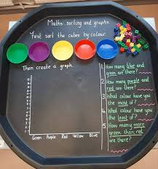
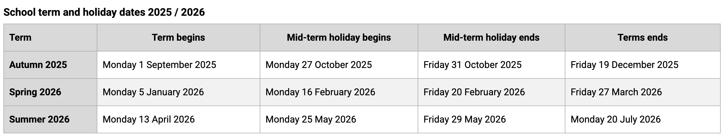

PTA News
A huge thank you to our wonderful PTA for their continued support and hard work this term. The Summer Fete was a fantastic success, and we’re so grateful to all the parents and families who came along and supported the event. Thanks to your generosity, the PTA raised an incredible £400! We're delighted to share that some of these funds have already been used to enhance our classrooms and curriculum – including the purchase of much-needed tough trays, helping to ensure that creative, hands-on learning experiences continue to thrive in our school.
Dates for the Diary
Dates for the Diary
14/7/25 | Y6 Leavers trip - Heatherton
15/7/25 | Y6 Leavers trip - BUZZ
16/7/25 | Year 6 Leavers’ Assembly 14:00 – 15:00 Y2 Trip to Oxwich
18/7/25 | INSET DAY – School Closed for ALL pupils
21/7/25 | INSET DAY – School Closed for ALL pupils
SUMMER HOLIDAYS
1/09/25 | INSET DAY – School Closed for ALL pupils
2/09/25 | Pupils return to school
15/09/25 | INSET DAY – School Closed for ALL pupils
As we approach the end of busy and enriching school year, I’d like to take this opportunity to sincerely thank you all for your continued support, encouragement, and involvement in school life. From supporting your child’s learning at home to cheering on performances, attending school events, and sharing your views, your partnership makes a real difference. Together, we continue to build a strong, caring school community where every child can thrive.
Best Wishes
Mrs A. Edwards
Headteacher
Working Together to Unlock Our Potential

